Slide 1
Statistics in R

Slide 2
Basic statistics today
T-tests
Correlations
One-Way Anova
Multiple Regression

Slide 3
Next up:
Two-Way Anova
Moderation
Interactions & Simple Slopes
Repeated-Measures Anova
Reliabilities
Factor Analysis

Slide 4
The General Linear Model
Y = a + BX + e
Y = B0 + B1X + e
Y = Intercept + Slope*(predictor) + error
Notes:
In its simplest form, the linear model looks like this. We’re predicting the values of Y based on an intercept (the baseline value of - in this case, where X = 0), plus the value of X for this observation, multiplied by a beta weight B, with some error e.

Slide 5
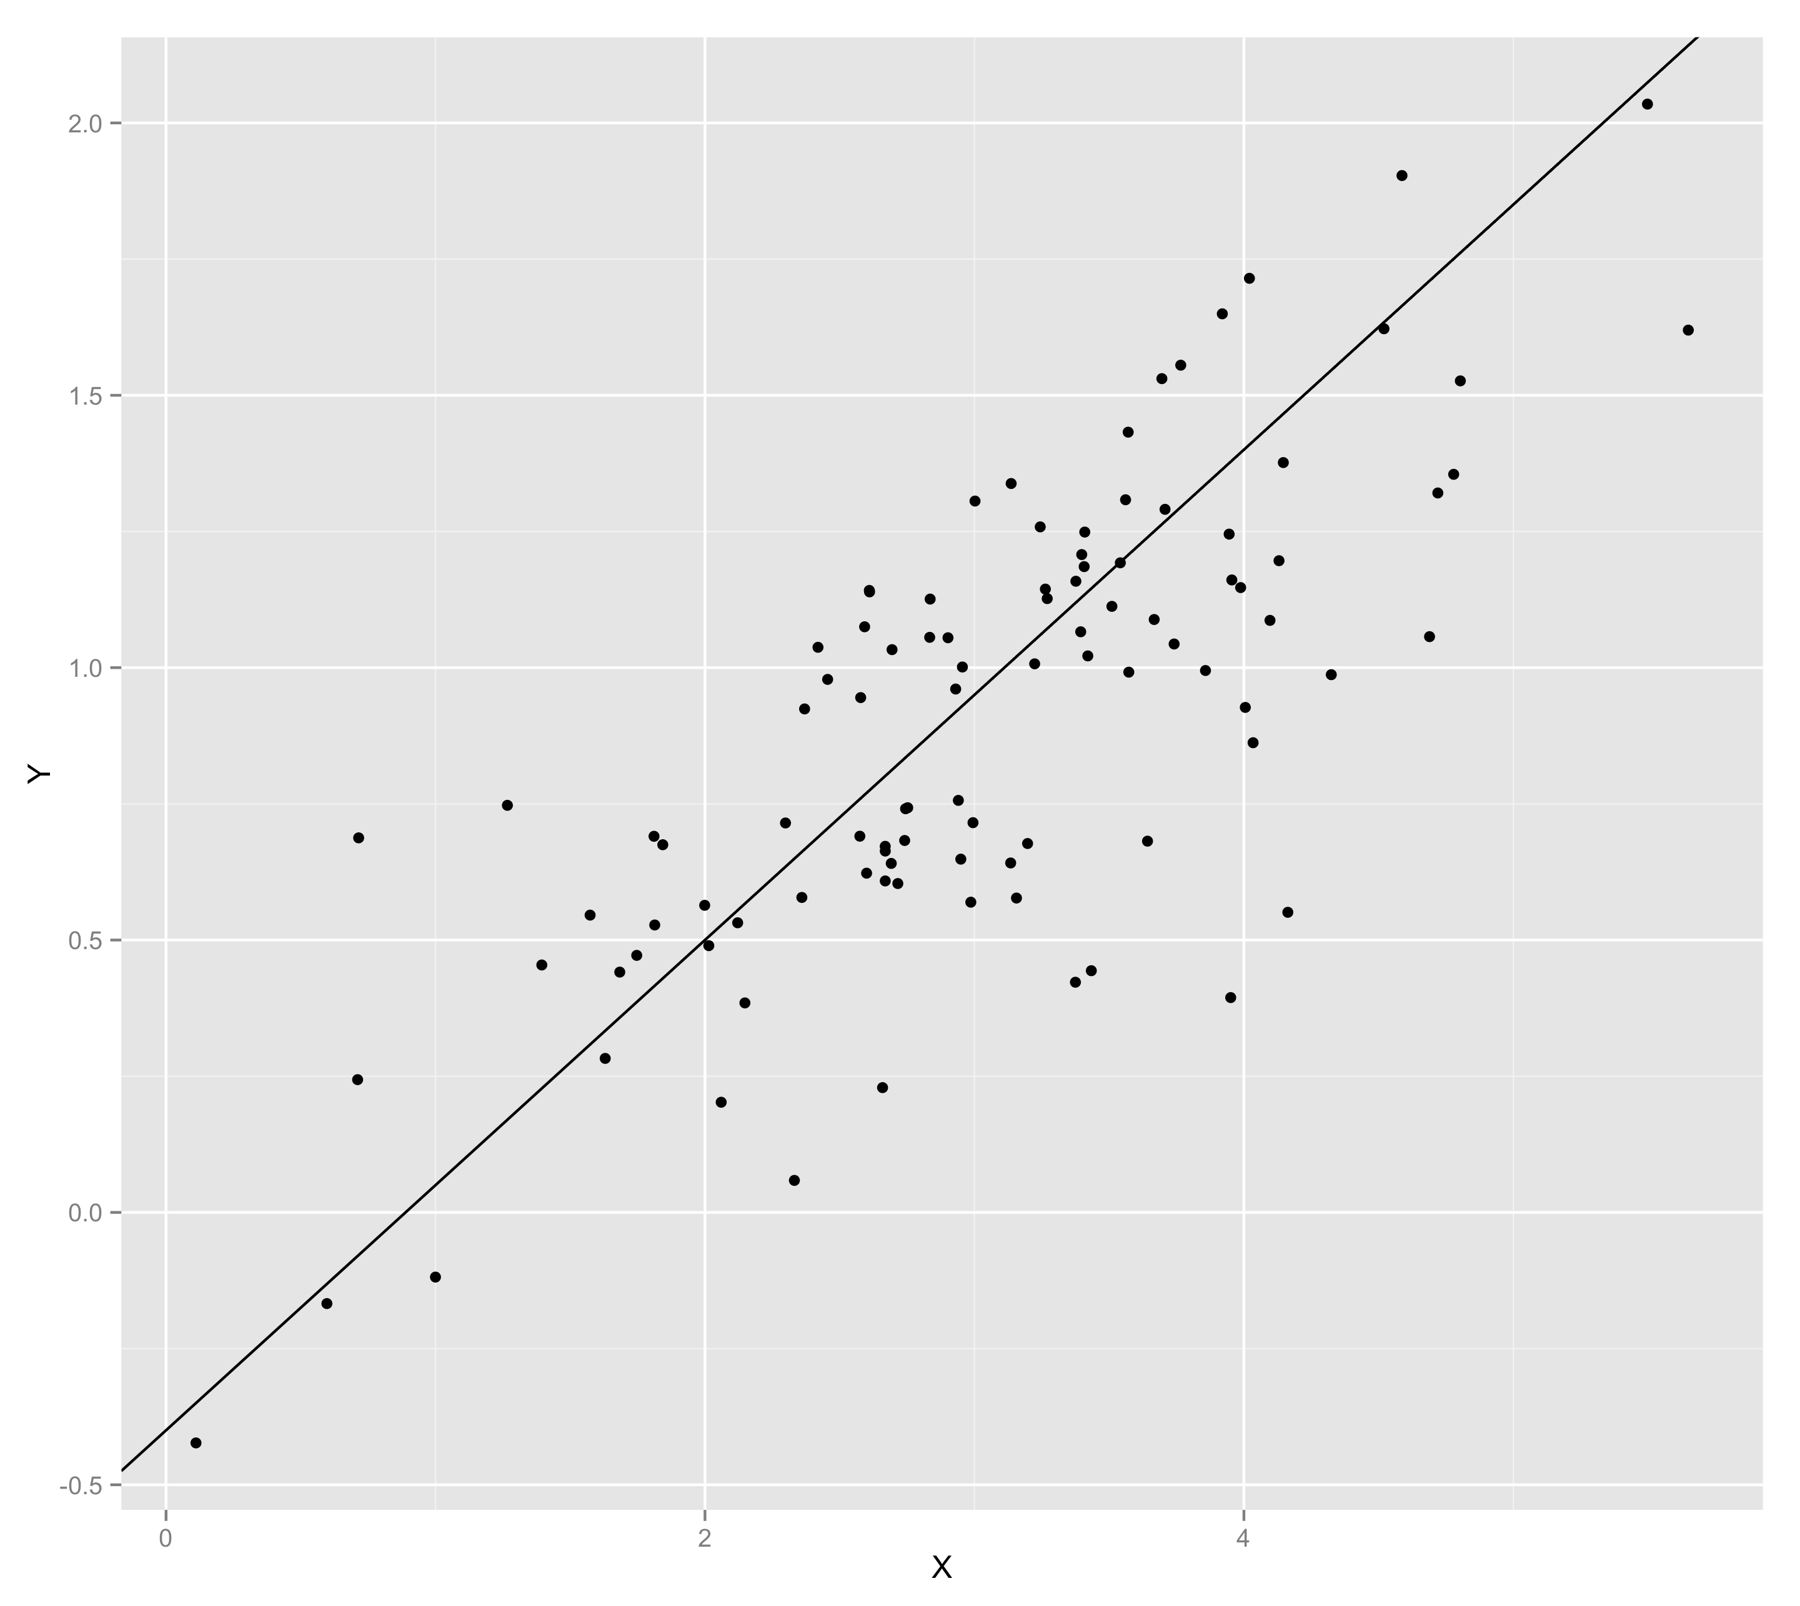
The General Linear Model
Y = -.4 + .45*X + error
Notes:
This corresponds to a linear model of something like Y = -.4 + .45*X + error

Slide 6
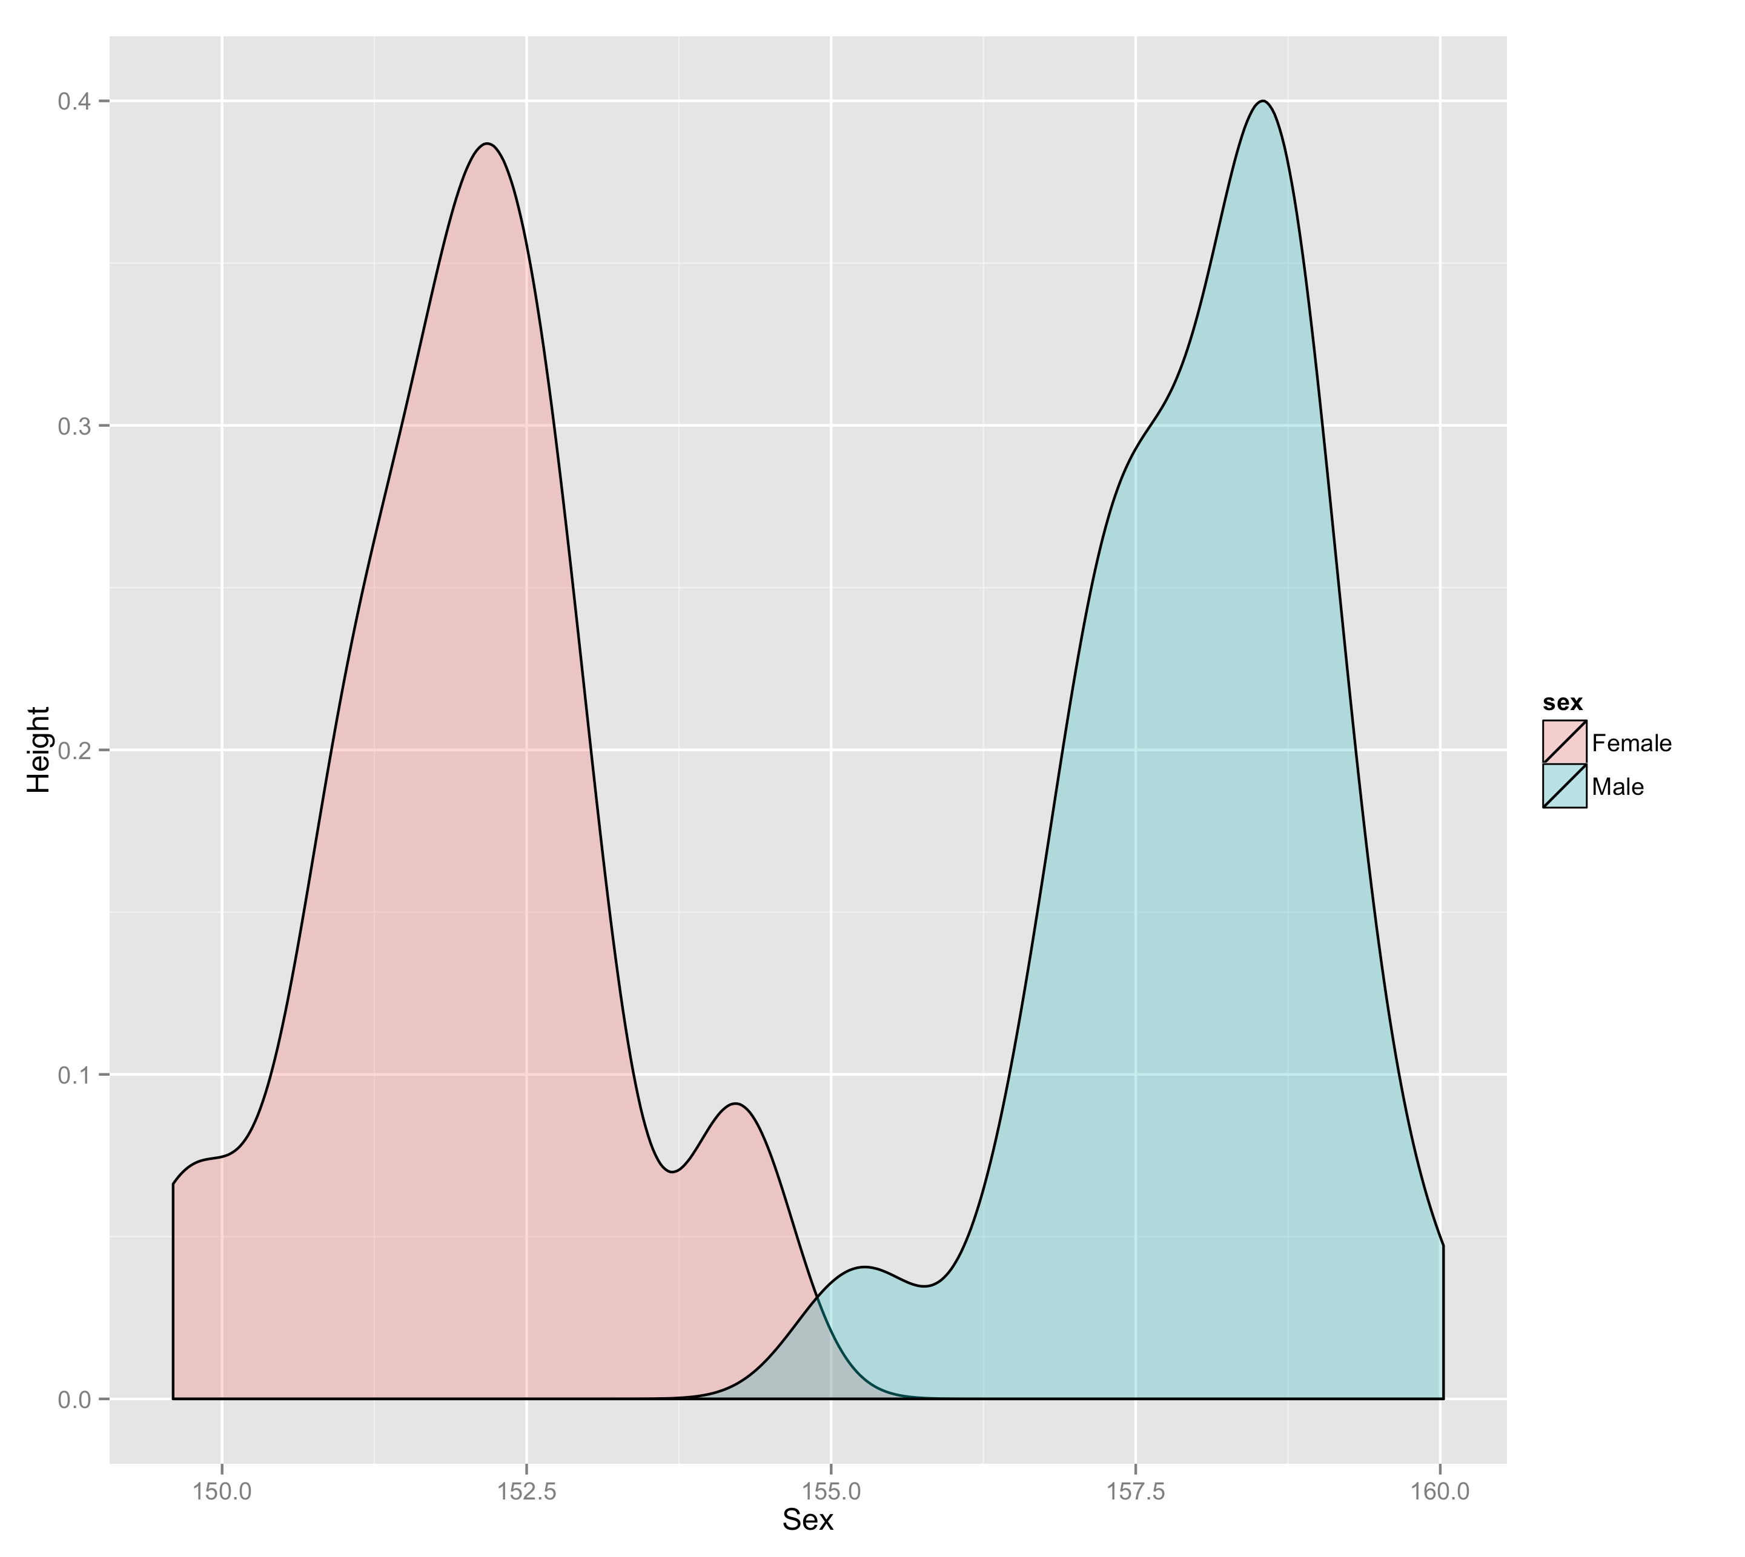
Frequency
Height
Notes:
That was continuous data. We tend to think of categorical data as something different, requiring different treatment. For two categories, we run a t test. For more than two, we run an anova to tell us whether there are differences between groups, then run followup tests to look for where those differences are. But we can flip things around pretty easily to fit categorical data into the linear model.

Slide 7
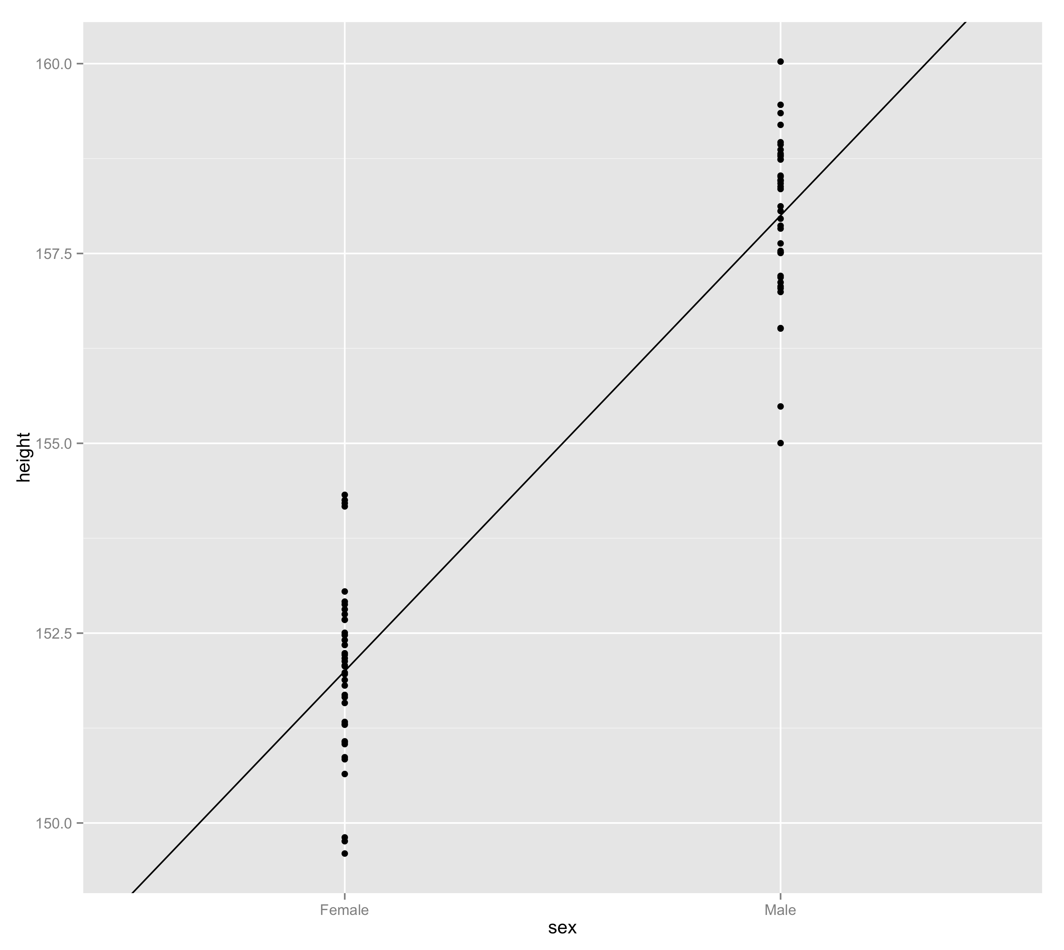
Height = intercept + B*sex + error
Notes:
For instance, if we draw a line through the group means for sex and height, we’re essentially recapturing a linear model. To fit a linear model to this data, we would dummy-code our categorical variable so that Female = 0 and Male = 1. That way, the intercept of our linear model, where our X variable = 0, would be the average height for a Female. Then the beta weight of the sex variable is the difference in height between males and females. It would be positive because males are taller. This makes intuitive sense, because we could then predict values for males using the average value for females, then adding the average difference between females and males.

Slide 8
Linear models in R
The syntax for a linear model in R looks like this:
y ~ 1 + x
1 represents the intercept. We specify our variables (like x). R calculates the betas (B) so we don’t write those. The error term is implied.
If we leave out the 1, R assumes we want an intercept, so this works too.
y ~ x
R uses this same formula for pretty much all analyses falling under the general linear model

Slide 9
Different analyses in R
(Assume X and Z are continuous variables, V is a two-level categorical and W a three-level categorical variable)
Simple regression
lm(Y ~ X)
Multiple regression
lm(Y ~ X + Z)
T-Test
lm(Y ~ V)
One-way ANOVA
lm(Y ~ W)
One-way ANCOVA
lm(Y ~ W + X)
Regression with interaction
lm(Y ~ X*Z)
Two-way anova
lm(Y ~ V*W)
Moderation
lm(Y ~ V*X) or lm(Y ~ W*X)
Notes:
Note that t.test has its own command for simplicity but running a regression with a 2-level categorical predictor is statistically identical.

Slide 10
How R handles analysis
Because R treats many different analyses by fitting them to the general linear model, it doesn’t show a huge amount of output by default when you fit a model.
Instead, we generally analyse data in two steps. We use a fitting function like lm() to fit a model to our data. Then we apply different functions to the model to get different output.

Slide 11
How R handles analysis
So we might start by fitting a model to our data with a categorical predictor. We do this by assigning the output of lm() to a variable.
model.1 <- lm(Y ~ W, data = mydata)

Slide 12
How R handles analysis
Now that our model has been fit, we can look at it in different ways
For example, if we wanted to look at regression-style output, we could use summary(model.1)
On the other hand, if we’re conceptually running an anova, we can use anova(model.1)

Slide 13
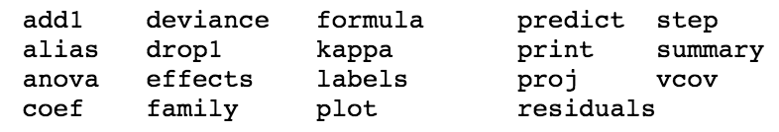
A list of ‘interrogation’ functions

Slide 14
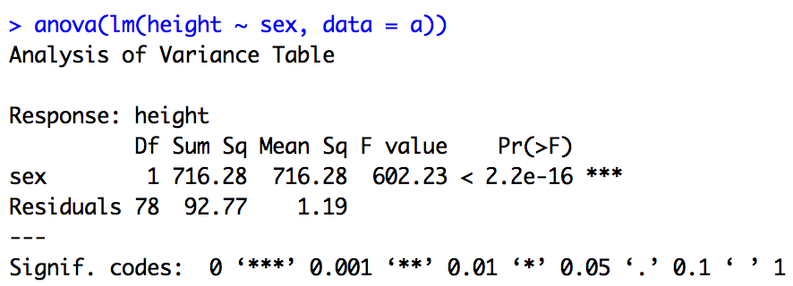
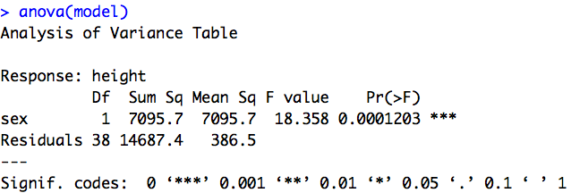
Reading anova output

Slide 15
Dummy coding in R
One of the reasons we usually analyse categorical predictors with ANOVA is because dummy-coding them for regression can get tedious.
We test for significant overall variation explained by our categorical predictors, then look at conditional means and plot them to see what’s going on if there is a significant difference and/or interaction between groups.
In R categorical variables are automatically dummy-coded when input into a regression.
Notes:
Apart from historical reasons to do with computing power

Slide 16
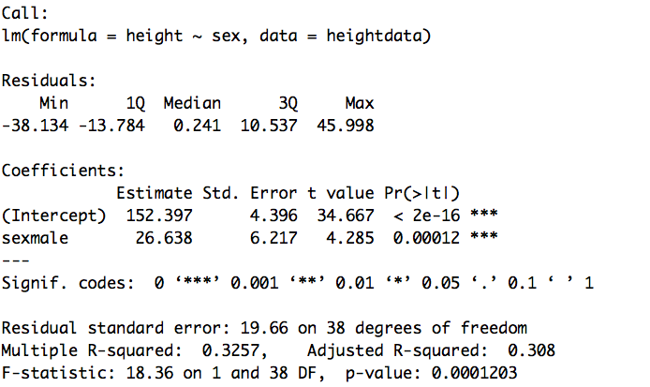
Reading regression output

Slide 17
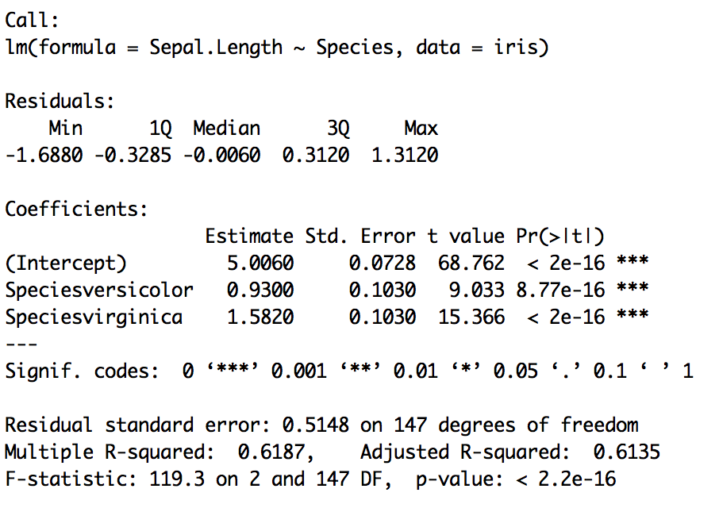
Notes:
In a dummy-coded model, intercepts represent the predicted value at the baseline of all factors modelled, and the zero-point of any continuous factors there might be. In this example, with only one factor modelled, the intercept represents the mean Sepal.Length when the Species is sets (not shown, because it’s captured in the Intercept parameter). Then the coefficient for each of the two other species is the mean difference between that species and setosa. Combining the intercept (setosa’s mean) with the difference between setosa and each other group gives us the predicted value for a flower in that group.

Slide 18
Same model, different analyses
Because many functions in R use this common linear model formula, it doesn’t take a lot to extend your knowledge to new analyses
For example, when we move on the multi-level modelling, we’ll be fitting models that look much the same, just with a few extra terms for random effects
lmer(Y ~ X + (1|Grouping factor), data = mydata)

